Slide 1
A movie recommender: classical machine learning versus deep learning
Biased matrix factorisation against NeuMF on MovieLens 100K
Track B
Notes:
Hello, welcome to my presentation about a movie recommendation system. A movie recommender system generally assesses the features of the viewers, the films and the interaction between viewers and the films. The primary goal is to suggest movies to the viewers that could be a good fit (Jayalakshmi et al., 2022).

Slide 2
Dataset: MovieLens 100K
01 / DATASET SELECTION AND PREPROCESSING
100,000
943
1,682
6.3%
ratings, 1 to 5 stars
viewers
films
of the table is filled
collected 1997 to 1998 (GroupLens Research, 1998)
gender, age, occupation
>= 20 ratings each
title, year, 19 genres
>=1 rating each
Sparsity: 93.7% of the movies have no rating from the average user
Notes:
For this presentation, I have used the MovieLens 100K. It contains 100,000 ratings and scarce information about 943 users and 1,682 films collected between 1997 and 1998.
We know gender, age and occupation of the viewers and there are 19 movie genres (one is unknown). Important to know is that only 6.3% of the table is filled. So, 93.7% of the movies do not have a rating from the average user. Every movie has at least one rating and every user has rated at least twenty films. There is sparsity in the dataset.

Slide 3
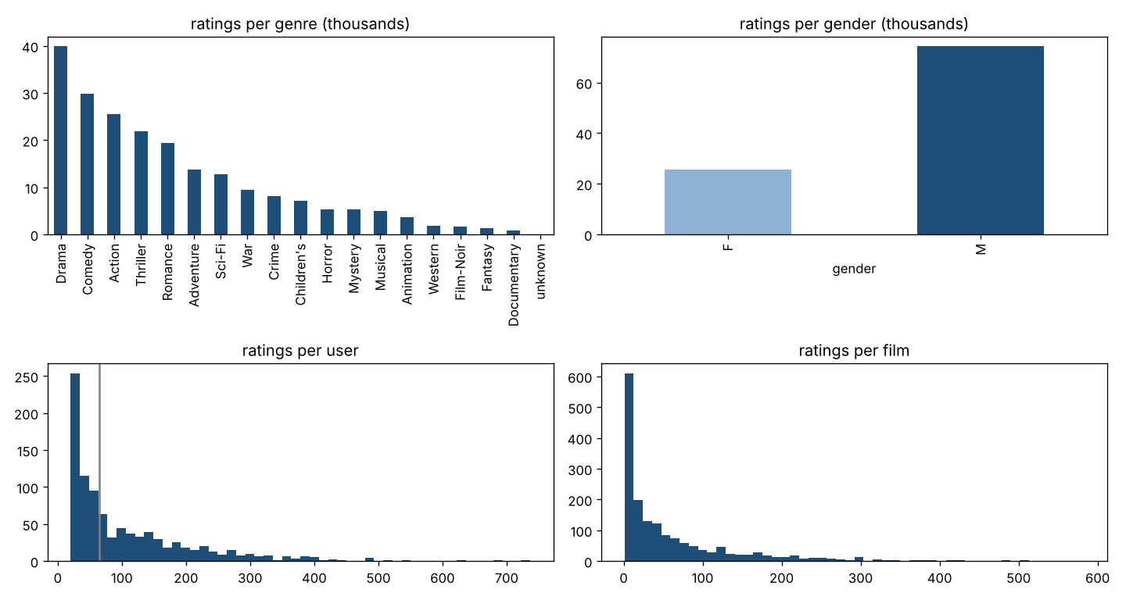
EDA
01 / DATASET SELECTION AND PREPROCESSING
The data is skewed, not evenly distributed
Most ratings go to a few genres (drama, comedy)
Men give around 74% of the ratings
Most viewers rate few films; most films get few ratings
We take this into account in the bias analysis
Notes:
We see that the data overall is skewed and not evenly distributed. The majority of the ratings are concentrated in a few categories (and the same is more or less true across users and films) and the majority of ratings are given by men (around 74%). We will take this into account when we study bias.

Slide 4
Preprocessing
01 / DATASET SELECTION AND PREPROCESSING
01
Data processing
02
Feature engineering
03
Side features
04
Five folds
Unknown genre dropped (18 unmodified)
Missing release date has median value
Age distributed over 7 buckets
21 occupations unmodified
Gender unmodified
48 side features
  Gender
  Age
  Occupation
  Genres
  Year
The dataset is split into five folds, 80% for training and 20% for testing. More on this later
→
→
→
Notes:
I have done minimal preprocessing. I have dropped the unknown genre, and I have kept the remaining 18. Age has seven buckets and I have kept the 21 occupations.
The dataset is splitted into five folds. The standard is 80% for training and 20% for testing. We will discuss this in more detail later.

Slide 5
Model selection (I): filtering strategies
02 / MODEL DESIGN: CLASSICAL ML VS DL
Strategy | Idea | Drawback
Collaborative | Viewers who rated the same movies similarly share interests (Zhang et al., 2020) | Cold start Computing grows with viewers × movies
Content-based | The content of the movie, for instance the genre, rather than behaviour | the viewer cannot discover new areas outside her profile (Idrissi and Zellou, 2020)
Hybrid | Combines strategies | Discussed in deployment
Content features are scarce and none has a significant effect, so collaborative is preferred
Sparsity hurts accuracy, coverage, scalability and transparency (Idrissi and Zellou, 2020; Gunathilaka et al., 2025)
Matrix factorisation estimates ratings from sparse data (Gunathilaka et al., 2025)
I use the biased version (Koren et al., 2009), the Netflix Prize winners. The library calls it SVD
Notes:
We talked about how the primary goal is to help users find relevant content (movies in this case). There are several filtering strategies used by traditional machine learning recommendation systems (Jayalakshmi et al., 2022). The three primary strategies are:
Collaborative filtering assumes that viewers who rated the same movies similarly share interests (Zhang et al., 2020). The strategy suffers from
Cold start problem: there is no information for a new viewer or movie;
Computing requirements grow with viewers times movies.
Content-based filtering uses the content, for instance the genre, rather than the behaviour of the viewers.
The drawback here is that the viewer cannot discover new areas outside her profile (Idrissi and Zellou, 2020).
Hybrids strategies combine them. We will discuss them later in deployment.
The content features are scarce, and based on statistical tests none have a significant effect, so I opted for collaborative filtering (Jayalakshmi et al., 2022). The cold start is not relevant here; I will discuss solutions to it later. What is more important is the sparsity in the data which affects all methods in terms of accuracy, coverage, scalability and transparency (Idrissi and Zellou, 2020; Gunathilaka et al., 2025). The literature discusses matrix factorization to estimate ratings from sparse data, so a way to mitigate sparsity (Gunathilaka et al., 2025). I use the biased version (Koren et al., 2009) the Netflix prize winners. The library calls it SVD in notebook.

Slide 6
Model selection (II): why a deep model, and which one
02 / MODEL DESIGN: CLASSICAL ML VS DL
01
Limit of biased MF
02
The choice: NeuMF (He et al., 2017)
03
Disadvantages of deep learning
The prediction is a dot product: linear relationships only
Deep learning can learn more, including non-linear effects and side features (Gunathilaka et al., 2025)
The survey by Zhang et al. (2019) classifies neural collaborative filtering as a representative model
A network between viewer and film instead of a dot product, it additionally learns side features and non-linear relationships
An excellent comparison to traditional MF
A black box
Needs a huge volume of data
More complexity overall
Notes:
Biased MF's prediction is a dot product, so it only represents linear relationships. Deep learning can learn more, for instance non-linear effects and side features (Gunathilaka et al., 2025).
For the deep model I chose NeuMF, neural matrix factorisation (He et al., 2017). The survey by Zhang et al. (2019) classifies the neural collaborative filtering as the representative model. The model adds a network between viewer and film instead of a dot product that allows learning about more side features and relationships. That’s why it makes an excellent comparison to traditional MF. However, there are also disadvantages to deep learning:
Its a black box;
The algorithms need huge volume of data;
There is more complexity overall

Slide 7
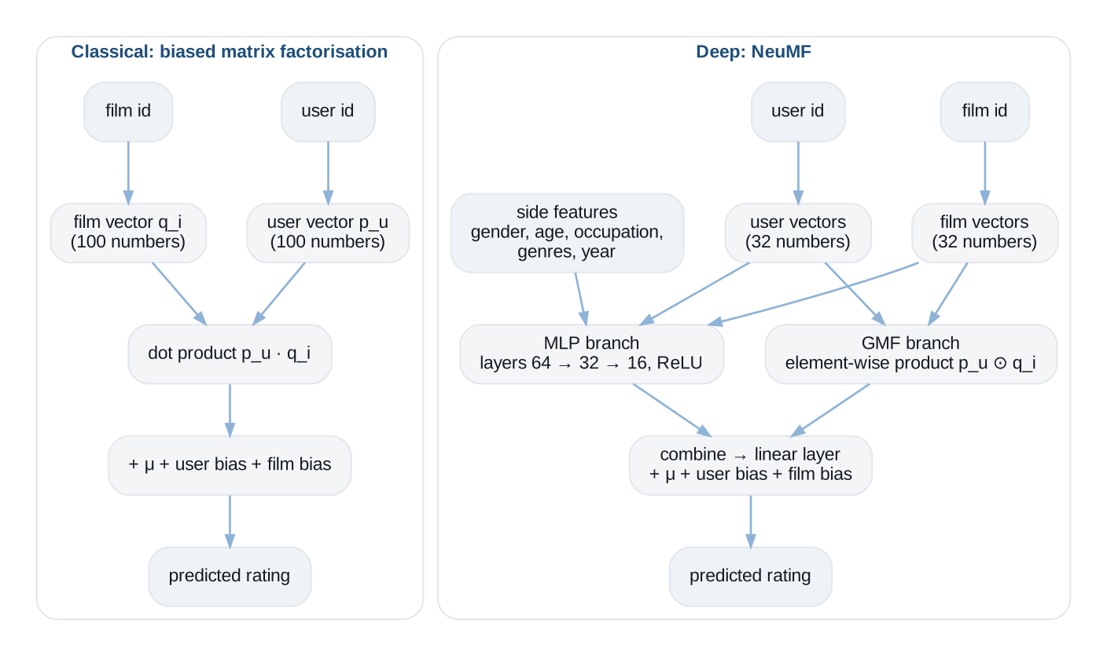
Model design
02 / MODEL DESIGN: CLASSICAL ML VS DL
Koren et al. (2009) and He et al. (2017)
Notes:
This diagram shows both models.
On the left biased MF. A user id and a film id each become a vector of 100 numbers, an embedding. The prediction is the dot product of the two vectors plus the global mean, the user bias and the film bias. The bias is based on the formula of Koren, Bell and Volinsky (2009), winners of the Netflix Prize.
In short, NeuMF looks up two short vectors per user and film, feeds them through a multiplication branch that is matrix factorisation and a network branch that can be non-linear and read the side features, combines the two, and adds the same averages as the classical model. The diagram is designed by me based off the articles and diagrams by Koren et al (2009) and He et al. (2017).

Slide 8
Results
03 / EVALUATION METRICS AND VALIDATION STRATEGY
RMSE: 0.912 vs 0.914: difference 0.002, fold to fold variation 0.008. Paired t-test p = 0.10: equally accurate
NDCG: 0.913 vs 0.911: the deep learning layers are not more accurate
Notes:
RMSE is the root mean squared error: the typical distance in stars between the predicted and the real rating. The lower the better. Biased MF scores 0.912 and NeuMF 0.914. The difference is 0.002, while the scores vary by 0.008 from fold to fold. A paired t-test over the five folds gives a p-value of 0.10. This means that the two models are equally accurate.
NDCG at 10 checks the order of the list instead of the stars. Per viewer I take the films in the test part that this viewer rated, let the model put them in order from the highest to the lowest predicted rating, and keep the top ten. Then I read the real ratings in that order. A film the viewer gave five stars earns the most, and every position lower in the list earns less. This sum is divided by the sum of the best possible order, so 1 means a perfect order. Viewers with fewer than five test ratings are skipped and I report the average over viewers. Biased MF scores 0.913 and NeuMF 0.911. So the deep learning layers of NeuMF are not more accurate for this metric.
Training takes 0.9 seconds per fold for biased MF and 6.4 for NeuMF.

Slide 9
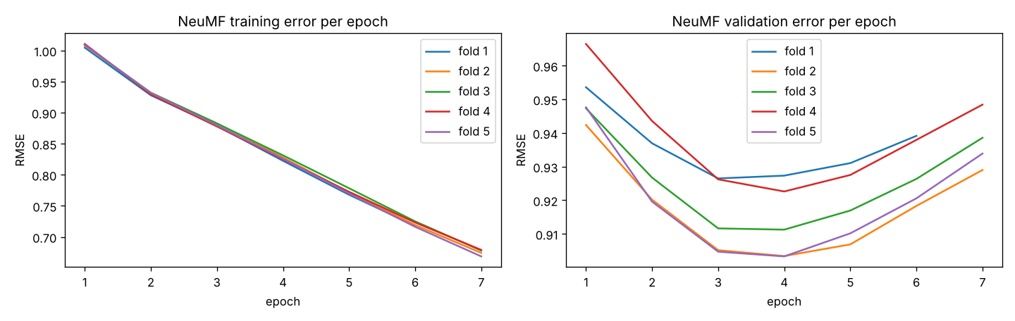
Evaluation metrics and overfitting
03 / EVALUATION METRICS AND VALIDATION STRATEGY
Folding strategy: trained and tested five times, average over the test parts, so no dependence on one lucky split. Hyperparameters chosen on the training part
Biased MF: training error 0.69, test error 0.93. The gap suggests overfitting
NeuMF: training error keeps improving, validation error stops improving after 3 to 4 epochs. Early stopping keeps the best weights
The folds make overfitting visible
Notes:
We talked earlier about the folding strategy. I trained and tested five times, once per fold, and analyzed the average over the test parts, so the number does not depend on one lucky split. The hyperparameters are chosen for the training part.
So, to discuss this in more detail. The training error is how far off the model is on the ratings it learned from, and the test error is based on the test dataset (the data it has not been trained on).
For biased MF, I noticed that the training error is 0.69 and the test error stands at 0.93. The gap suggests overfitting.
For deep learning NeuMF model the training error keeps improving while the validation error was not improving after three to four epochs. That is why the early stopping kicked in to prevent overfitting and to keep the best weights.
The folding strategy allowed us to train the data in a way that we were able to make overfitting visible.

Slide 10
Hyperparameters and grid search
02 / MODEL DESIGN: CLASSICAL ML VS DL
Hyperparameter | What it does | Chosen
λ regularisation | Penalty on large vector numbers | 0.1
factors | How many numbers are included in the vector (length) | 100
epochs | passes over the training ratings | 40
learning rate | step size per update | 0.01
NeuMF embedding size | See factors, the length of the vectors | 32
NeuMF dropout | share of network units switched off per step so it relies less on a few | 0.2
Grid search on the training fold 1
Lambda was the only significant hyperparameter: error 0.966 → 0.931 for λ 0.02 → 0.1
NeuMF settings varied slightly, followed 32 and 0.2 as in He et al. (2017)
Notes:
So Lambda is the regularization hyperparameter that penalizes large numbers in the vectors. The model minimises the error on the training ratings plus lambda times the size of the vectors. With lambda at zero the model may overfit the training data resulting in memorization. The higher lambda means that prediction leans more on averages and less on the features captured in the vectors.
Using grid search on the training folds the best hyperparameters were 100 factors, 40 epochs, learning rate 0.01 and lambda 0.1. Lambda was the only significant hyperparameter, the error improved from 0.966 to 0.931 when lambda went from 0.02 to 0.1.
NeuMF model has two additional hyper parameters. The embedding size is the length of its vectors. Dropout switches off a random share of the network units at every training step, so the network cannot lean on a few units and overfits less. I tried several settings and they did not result in any differences, so I used the values 32 and 0.2 as in He et al. (2017).

Slide 11
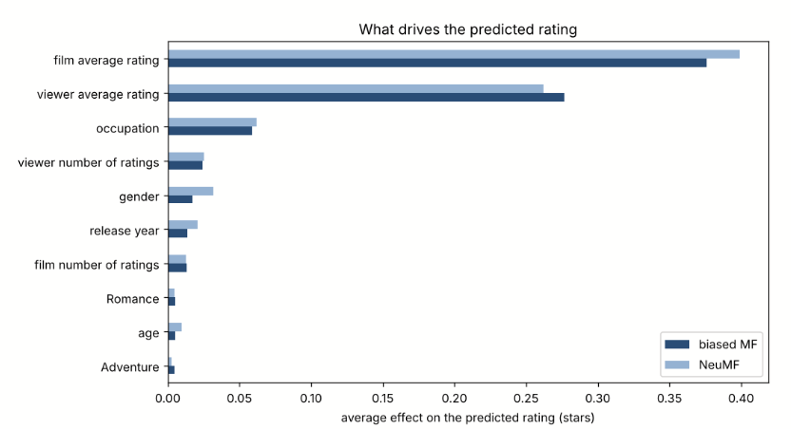
Explainability: SHAP
04 / EXPLAINABILITY FINDINGS
Biased MF and NeuMF: Tree SHAP model because vectors are not interpretable by humans (Lundberg and Lee, 2017)
Both models rely on the film's average (0.4) and the viewer's average (0.27)
NeuMF: kernel SHAP for all side features, on occupation and gender most significant
Notes:
SHAP (Lundberg and Lee, 2017) splits one prediction into a contribution per feature. The vectors are not really interpretable by a human, therefore I use features in SHAP for the explanation. For classical ML model I have used a tree SHAP. The tree model is interpretable and SHAP can then interpret the tree.
The features, thus, are not used by the actual models themselves.
Both classical and the deep learning models rely on the film's average, about 0.4, and the viewer's average, about 0.27. On NeuMF I also did local SHAP (where we can vary the features and observe the changes in the prediction) to study occupation and gender. Results show that healthcare occupation lowers the prediction by 0.16. NeuMF is not fully explainable unfortunately.

Slide 12
Bias and ethics
05 / ETHICAL AND BIAS CONSIDERATIONS
Group | Size | Share of ratings | RMSE biased MF | RMSE NeuMF
Women | 273 viewers | 26% | 0.961 | 0.962
Men | 670 viewers | 74% | 0.895 | 0.897
Viewers with 20 to 50 ratings | 380 viewers | 12% | 0.987 | 0.991
Viewers with over 200 ratings | 148 viewers | 44% | 0.889 | 0.891
Films with under 10 ratings | 530 films | 2% | 1.049 | 1.049
Films with 150+ ratings | 203 films | 48% | 0.886 | 0.885
Sampling bias: women are underrepresented and have a 0.07 higher error (Ekstrand et al., 2018)
Overprediction: Films with fewer than 10 ratings are overpredicted by 0.23 stars and have a 0.16 higher error. Involves 530 out of 1,682 films
Popularity bias: only 225 (NeuMF 167) of 1,682 films appear in a top 10 list
  Reserve a share of every top-N list for infrequently rated films by re-ranking (Abdollahpouri et al., 2019)
Notes:
The table confirms what Ekstrand et al. (2018) also found on MovieLens that women are underrepresented and they have slightly higher error rate of 0.07. This is a sampling bias.
MF seems to overpredict when data is scarce prediction data for a movie as movies with fewer than 10 ratings have are overpredicted by 0.23 stars and have higher error rate of 0.16. This represents about 530 out of the 1.682 films.
There is a popularity bias as only 225 (167 DL) of 1.682 movies have a recommendation.
What would I do? Always reserve a share of every top-N list for infrequently rated films by re-ranking (Jayalakshmi et al., 2022; Abdollahpouri et al., 2019) against popularity bias.

Slide 13
Deployment
06 / DEPLOYMENT CONSIDERATIONS
01
Scalability
02
Precompute
03
Real time
04
Per segment and monitoring
Requirements depends on the objective of the application
Interactions grow significantly with viewers × movies
Safe assumption that most viewers watch less than a movie a day
Solution: Recommendations precomputed overnight on a cloud server
Deploy hybrid system:
1. Select top N candidates per viewer on content features
2. Compute the recommendations only for preselected movies. (Zhang et al., 2020)
Popularity bias: every top N selection keeps a share for infrequently rated films (Abdollahpouri et al., 2019)
Content-based with an onboarding questionnaire for new users
Monitor the error rate and retrain when the data changes
→
→
→
Notes:
Scalability is a concern because the number of interactions grows significantly as users and/or movies are added to the platform. But is based on the requirements of the viewers.
It is reasonable to assume that the majority of users view less than a movie every day, therefore I would precomputing recommendations overnight on a server deployed in the cloud
If real-time analysis is a concern, I would implement a hybrid strategy based on content features we select top N per viewer and compute the recommendations. This will drastically reduce the required computing power (Zhang et al., 2020)
Every top N keeps a share for infrequently rated films (Jayalakshmi et al., 2022; Abdollahpouri et al., 2019).
I would implement a content-based strategy with onboarding questionnaire for new users
I would monitor the error rate and retrain based on changes in the data

Slide 14
Conclusion
07 / SUMMARY
Biased MF matches NeuMF on RMSE and is slightly better on NDCG, so for this experiment the classical model is preferred because it is more efficient
Scarce features and 100,000 rows is little for a deep learning model, therefore no significant difference was expected
The models are arguably not very explainable given that the vectors are not interpretable by humans
We have discussed deployment considerations based on the purpose of the application
We have discussed sampling bias for women, popularity bias against inactive viewers and rarely rated films
Thanks for listening
Notes:
To conclude. Biased MF matches NeuMF on RMSE and is slightly better on NDCG and the classical machine learning algorithm is more efficient and explainable.
We do have scarce features, and 100.000 rows is little for DL model, so it was expected to not see any major differences.
We have sampling bias for women and popularity bias against inactive viewers or rarely rated films. We have discussed various strategies on how to handle these concerns.

Slide 15
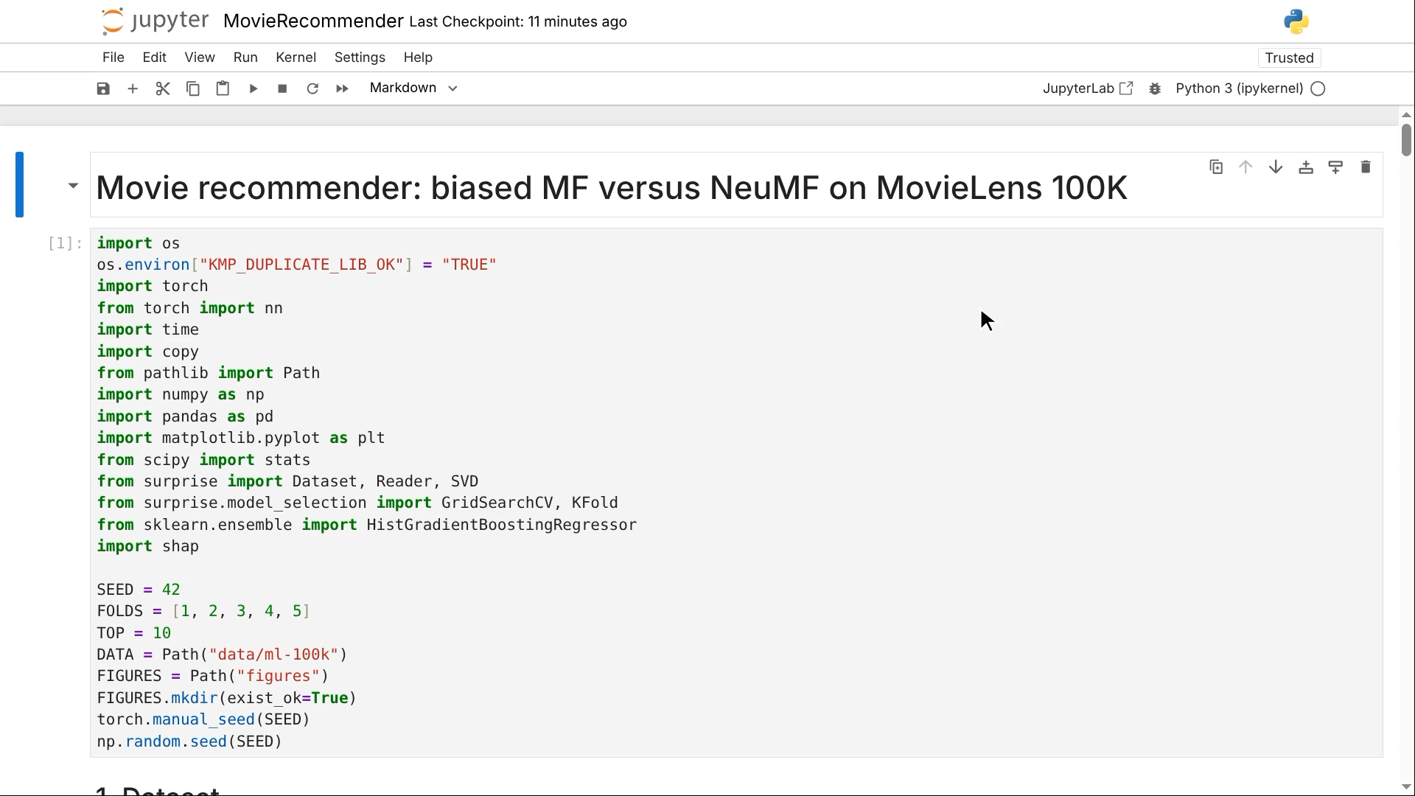
Demonstration
08 / Demonstration
Notes:
To conclude. Biased MF matches NeuMF on RMSE and is slightly better on NDCG and the classical machine learning algorithm is more efficient and explainable.
We do have scarce features, and 100.000 rows is little for DL model, so it was expected to not see any major differences.
We have sampling bias for women and popularity bias against inactive viewers or rarely rated films. We have discussed various strategies on how to handle these concerns.

Slide 16
References
09 / APPENDIX
Abdollahpouri, H., Burke, R. and Mobasher, B. (2019) ‘Managing popularity bias in recommender systems with personalized re-ranking’, in Proceedings of the 32nd International Florida Artificial Intelligence Research Society Conference (FLAIRS-32). Sarasota, FL, 19–22 May. Palo Alto, CA: AAAI Press. Available at: https://arxiv.org/abs/1901.07555 (Accessed: 1 October 2026).
Ekstrand, M.D., et al. (2018) ‘All the cool kids, how do they fit in? Popularity and demographic biases in recommender evaluation and effectiveness’, in Proceedings of the 1st Conference on Fairness, Accountability and Transparency. New York, NY, 23–24 February. Proceedings of Machine Learning Research, 81, pp. 172–186. Available at: https://proceedings.mlr.press/v81/ekstrand18b.html (Accessed: 5 October 2026).
GroupLens Research (1998) MovieLens 100K Dataset. Minneapolis, MN: University of Minnesota. Available at: https://grouplens.org/datasets/movielens/100k/ (Accessed: 1 October 2026).
Gunathilaka, T.M.A.U., et al. (2025) ‘Addressing sparse data challenges in recommendation systems: a systematic review of rating estimation using sparse rating data and profile enrichment techniques’, Intelligent Systems with Applications, 25, 200474. doi:10.1016/j.iswa.2024.200474 (Accessed: 1 October 2026).
Harper, F.M. and Konstan, J.A. (2015) ‘The MovieLens datasets: history and context’, ACM Transactions on Interactive Intelligent Systems, 5(4), article 19, pp. 1–19. doi:10.1145/2827872 (Accessed: 1 October 2026).
He, X., et al. (2017) ‘Neural collaborative filtering’, in Proceedings of the 26th International Conference on World Wide Web (WWW 2017). Perth, Australia, 3–7 April. Geneva: International World Wide Web Conferences Steering Committee, pp. 173–182. doi:10.1145/3038912.3052569 (Accessed: 1 October 2026).
Idrissi, N. and Zellou, A. (2020) ‘A systematic literature review of sparsity issues in recommender systems’, Social Network Analysis and Mining, 10, article 15. doi:10.1007/s13278-020-0626-2 (Accessed: 2 October 2026).
Jayalakshmi, S., et al. (2022) ‘Movie recommender systems: concepts, methods, challenges, and future directions’, Sensors, 22(13), 4904. doi:10.3390/s22134904 (Accessed: 1 October 2026).
Koren, Y., Bell, R. and Volinsky, C. (2009) ‘Matrix factorization techniques for recommender systems’, Computer, 42(8), pp. 30–37. doi:10.1109/MC.2009.263 (Accessed: 1 October 2026).
Lundberg, S.M. and Lee, S.-I. (2017) ‘A unified approach to interpreting model predictions’, in Advances in Neural Information Processing Systems 30 (NIPS 2017). Long Beach, CA, 4–9 December. Red Hook, NY: Curran Associates, pp. 4765–4774. Available at: https://arxiv.org/abs/1705.07874 (Accessed: 1 October 2026).
Narayanan, A. and Shmatikov, V. (2008) ‘Robust de-anonymization of large sparse datasets’, in Proceedings of the 2008 IEEE Symposium on Security and Privacy. Oakland, CA, 18–21 May. Washington, DC: IEEE Computer Society, pp. 111–125. doi:10.1109/SP.2008.33 (Accessed: 3 October 2026).
Zhang, J., et al. (2020) ‘Personalized real-time movie recommendation system: practical prototype and evaluation’, Tsinghua Science and Technology, 25(2), pp. 180–191. doi:10.26599/TST.2018.9010118 (Accessed: 1 October 2026).
Zhang, S., et al. (2019) ‘Deep learning based recommender system: a survey and new perspectives’, ACM Computing Surveys, 52(1), article 5, pp. 1–38. doi:10.1145/3285029 (Accessed: 1 October 2026).
Notes:
The reference list.

